Slide 1

House Price Predictive Modelling
By : Harjeet Kaur
INSAID June2019 Cohort

Slide 2
House Price Prediction Model
This is a House dataset having 1460 observation and 81 different variables.
A house value is simply more than location and square footage. The person wants to knows about different features, like totalArea, Location, Neighbourhood, GarageArea, Quality of contruction.
Client Housebuyer: This client wants to find their next dream home with a reasonable price tag. They have their locations of interest ready. Now, they want to know if the house price matches the house value. With this study, they can understand which features (ex. Number of bathrooms, location, etc.) influence the final price of the house. If all matches, they can ensure that they are getting a fair price.
Client Houseseller: Think of the average house-flipper. This client wants to take advantage of the features that influence a house price the most. They typically want to buy a house at a low price and invest on the features that will give the highest return. For example, buying a house at a good location but small square footage. The client will invest on making rooms at a small cost to get a large return.

Slide 3
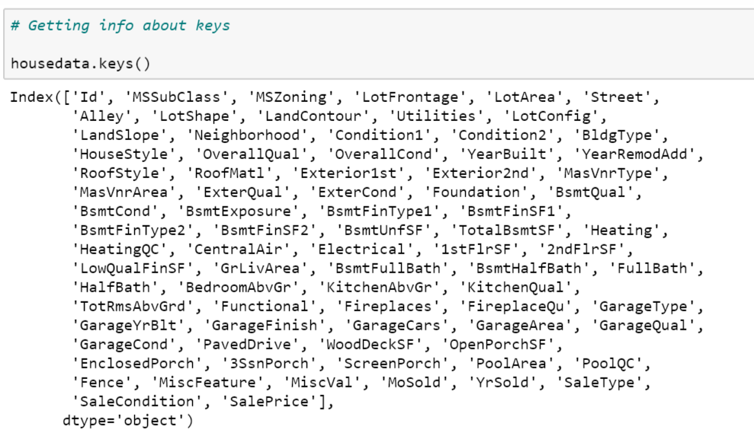
House price dataset - Keys

Slide 4
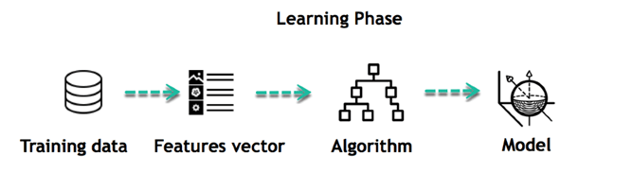
Objective of Machine Learning Model
Build ML Model to Predict the SalePrice of House based on given parameters.

Slide 5
Model Build Process
Performed the below three iterations to select the different set of independent variable features to check their impact on target variable and model accuracy.
Select 10 highly corelated features to build model
Select 15 highly corelated features to build model
Consider all the numerical and categorical features upto 161 to build the model

Slide 6
EDA

Slide 7
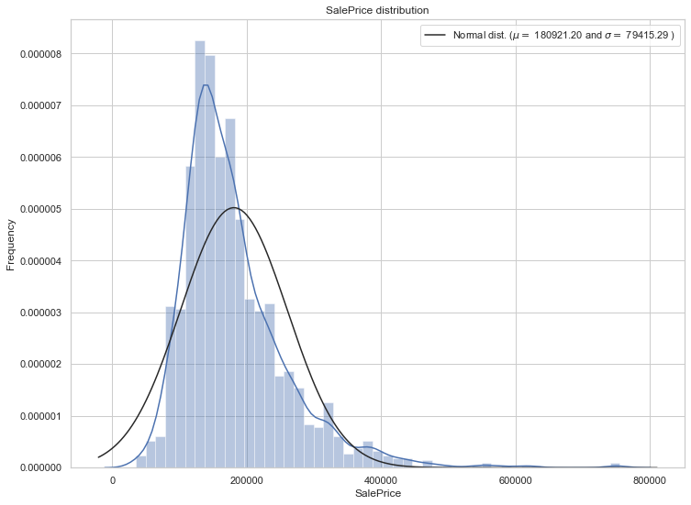
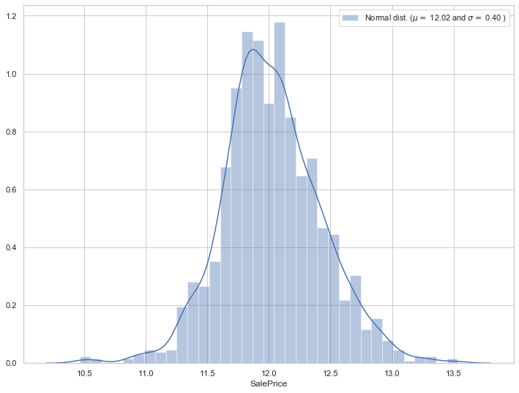
Target Variable – Sale Price of House
Sale Price little right skewed in original dataset
Sale Price become Normally distributed after log transformation.

Slide 8
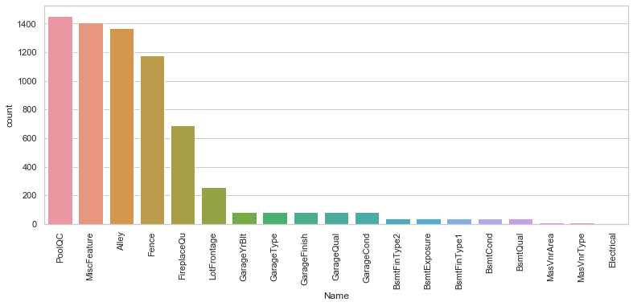
Missing Values in Dataset

Slide 9
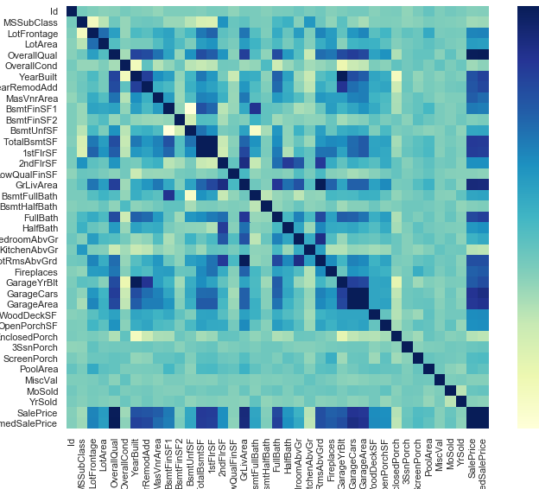
Correlation Matrix – Heat map of different features

Slide 10
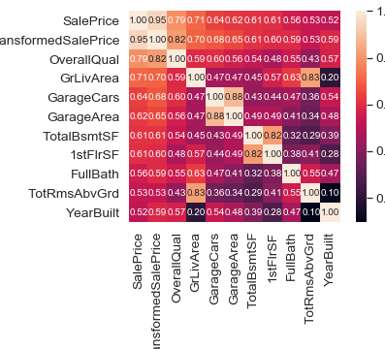
Selection of 10 most Significant numerical features of House data

Slide 11
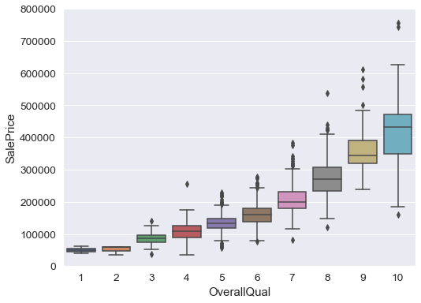
OverallQual Vs SalePrice

Slide 12
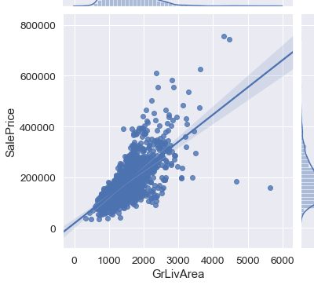
Living Area Vs SalePrice

Slide 13
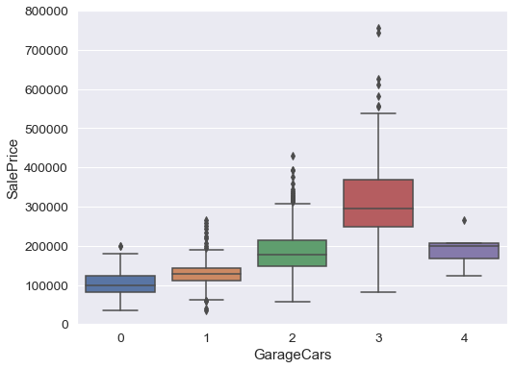
# GarageCars Vs SalePrice

Slide 14
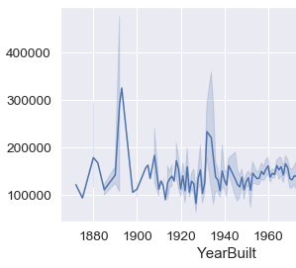
YearBuilt vs Sale Price

Slide 15
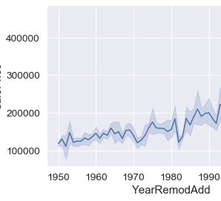
Remodal vs Sale Price

Slide 16
Creating Model with 10 significant feature variables
Applied below mentioned models
Linear Regression
Linear gridSearchCV
Random Forest Regressor
Evaluate model metrics and accuracy
MAE
MSE
RMSE
R2 score
- Accuracy

Slide 17
Result of Model with 10 features
 | Model | MAE | R Squared | RMSE | R2Score
0 | Linear Regression | 0.278 | 0.163 | 0.404644 | 0.842791
1 | Random Forest Regressor | 0.226 | 0.118 | 0.344005 | 0.886378

Slide 18
Result of Model with 15 features
 | Model | MAE | R Squared | RMSE | R2Score
0 | Linear Regression | 0.256 | 0.134 | 0.367414 | 0.870388
1 | Random Forest Regressor | 0.209 | 0.103 | 0.322396 | 0.900204

Slide 19
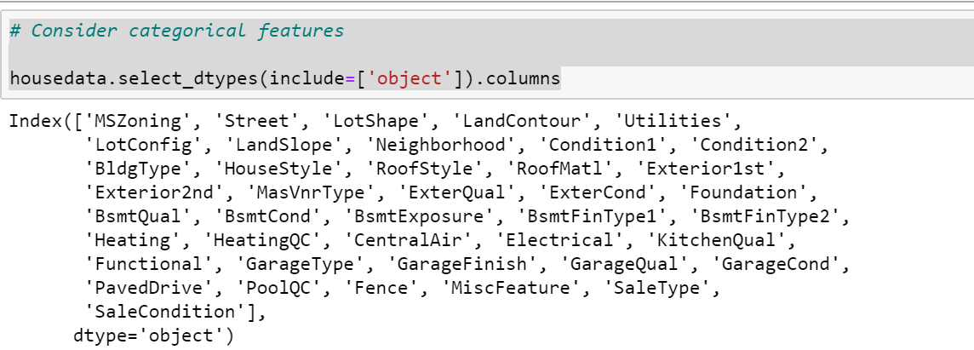
Consider all the categorical features of the dataset

Slide 20
Feature Engineering
Handling Missing Values
Feature Scaling
Dummification for categorical features
Feature Reduction
PCA – Principle Component Analysis

Slide 21
Model Building
Linear Regression
Random Forest Regressor

Slide 22
Result of selection of 161 features using PCA method
 | Model | MAE | R Squared | RMSE | R2Score
0 | Linear Regression | 0.108 | 0.092 | 0.304405 | 0.421076
1 | Random Forest Regressor | 0.101 | 0.020 | 0.142836 | 0.872534

Slide 23
Comparison of Accuracy of Model
Model | Accuracy
0 | Random Forest Regressor_10 | 88.63
1 | Random Forest Regressor_15 | 90.02
2 | Random Forest Regressor_161 | 87.25

Slide 24
Thank you
harjeet31@gmail.com
https://github.com/harjeet31/House-Price-Prediction-Model

